Slide 1


Department of Computer Science and Engineering
CS19643 – FOUNDATIONS OF MACHINE LEARNING
MEDICINAL PLANT DETECTION SYSTEM
Akalya G
210701021
Aravind S 210701033
Dr.S. Vinodkumar
Professor

Slide 2
Abstract
This project automates the detection and classification of medicinal plants using the YOLOv8 (You Only Look Once) object detection algorithm. Traditional identification methods are labor-intensive and require expert knowledge, limiting large-scale applications. By fine-tuning the pre-trained YOLOv8 model with a custom dataset of annotated plant images, the system achieves high accuracy in real-time plant identification. The training involves setting up a configuration file (data.yaml) and evaluating the model with a test set. The resulting system provides visual and textual outputs of detected plants, aiding botanical research, conservation, and agriculture by streamlining the identification process.

Slide 3
Existing System
The current approach to identifying medicinal plants typically involves manual observation by botanical experts, aided by field guides and taxonomic keys. This process is labor-intensive, time-consuming, and subjective, leading to inconsistencies in identification results. Expert dependence restricts scalability, while the lack of accessibility to botanical expertise limits the applicability of traditional methods. Moreover, manual processes are prone to errors, especially in large-scale surveys or remote regions. As a result, there is a growing need for automated systems to improve the efficiency and accuracy of medicinal plant identification, addressing the limitations of traditional methods and facilitating broader access to plant identification capabilities.

Slide 4
Proposed System
The proposed system leverages the power of the YOLO (You Only Look Once) algorithm v8 to revolutionize the way medicinal plants are identified, classified, and monitored. This innovative software solution offers a streamlined and highly accurate approach to plant management.
Automated Plant Identification: The system can rapidly and precisely identify a wide variety of medicinal plant species, reducing the reliance on manual, error-prone methods.
Intelligent Classification: The software categorizes medicinal plants based on their unique visual characteristics, enabling researchers and practitioners to efficiently manage and track different plant varieties.
Real-time Monitoring: The system can continuously monitor medicinal plant populations, providing valuable insights into growth patterns, health status, and environmental factors that influence their well-being.

Slide 5
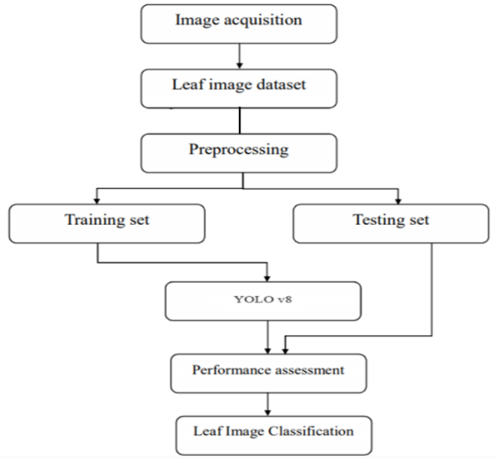
Flow Diagram

Slide 6
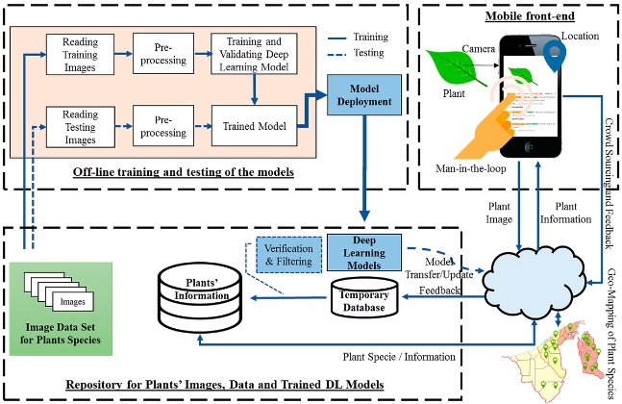
System Architecture

Slide 7
List of Modules
Dataset Collection and Annotation Module
Model Training and Optimization Module:
System Development Module:
Evaluation and Deployment Module:

Slide 8
Functional Description for each modules
Dataset Collection and Annotation Module:
This module focuses on acquiring a diverse set of annotated medicinal plant images. Through Data Sourcing, images will be gathered from botanical gardens, online repositories, and herbarium collections. Data Annotation will involve manual annotation by experts, marking bounding boxes around plant instances and assigning class labels.

Slide 9
Functional Description of Module
Model Training and Optimization Module: Here, the YOLOv8 model will be fine-tuned for medicinal plant detection. Model Architecture Selection will determine the best YOLOv8 variant. Transfer Learning will utilize pre-trained weights for faster training, while Hyperparameter Optimization will optimize parameters for accuracy and efficiency.

Slide 10
Functional Description of Module
System Development Module: This module aims to create an intuitive system for dataset management and model training. User Interface Design will craft an easy-to-use interface for image uploading and annotation. Backend Development will ensure robustness in data storage and model training pipelines. Result Visualization will provide tools for analyzing detection results.

Slide 11
Functional Description of Module
Evaluation and Deployment Module : Before deployment, the model's performance will be thoroughly evaluated. Performance Evaluation will assess metrics like accuracy and precision. Cross-Validation will ensure the model's generalization across different conditions. Deployment will integrate the model into existing systems for practical use.

Slide 12
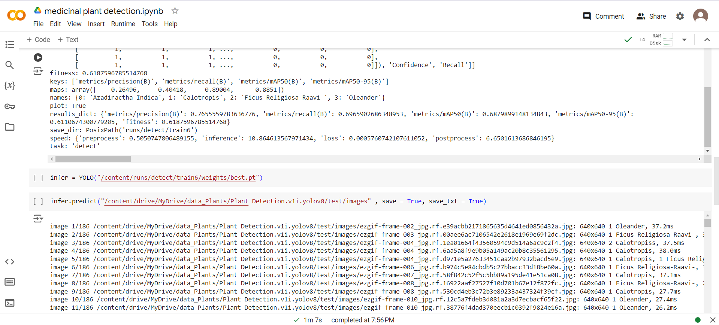
Implementation

Slide 13
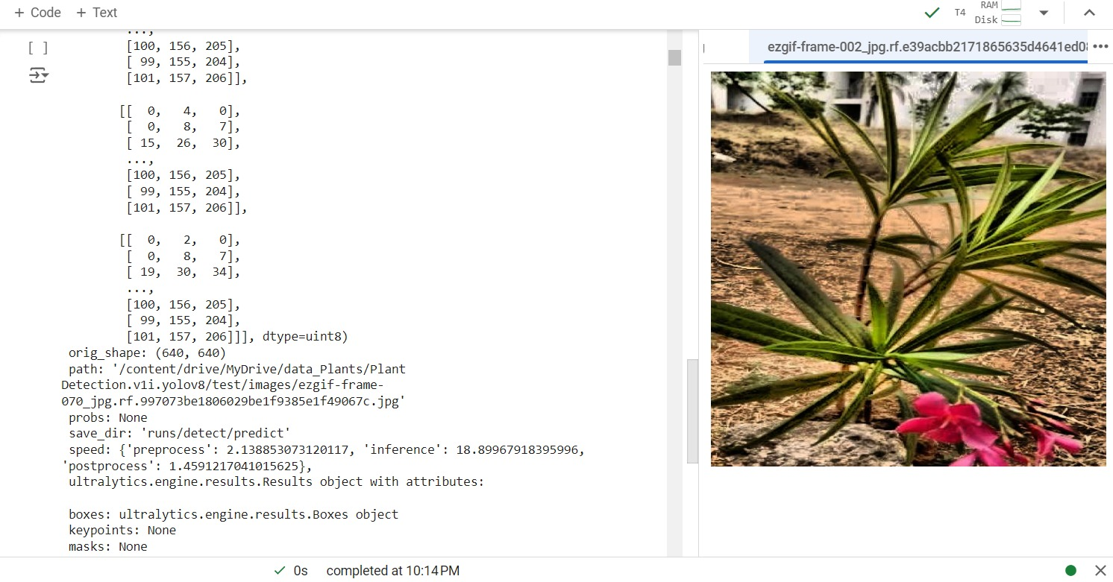
Output
Accurate Identification
The advanced machine learning algorithms accurately identify and classify a wide range of medicinal plant species, empowering practitioners to effectively manage their collections.

Slide 14
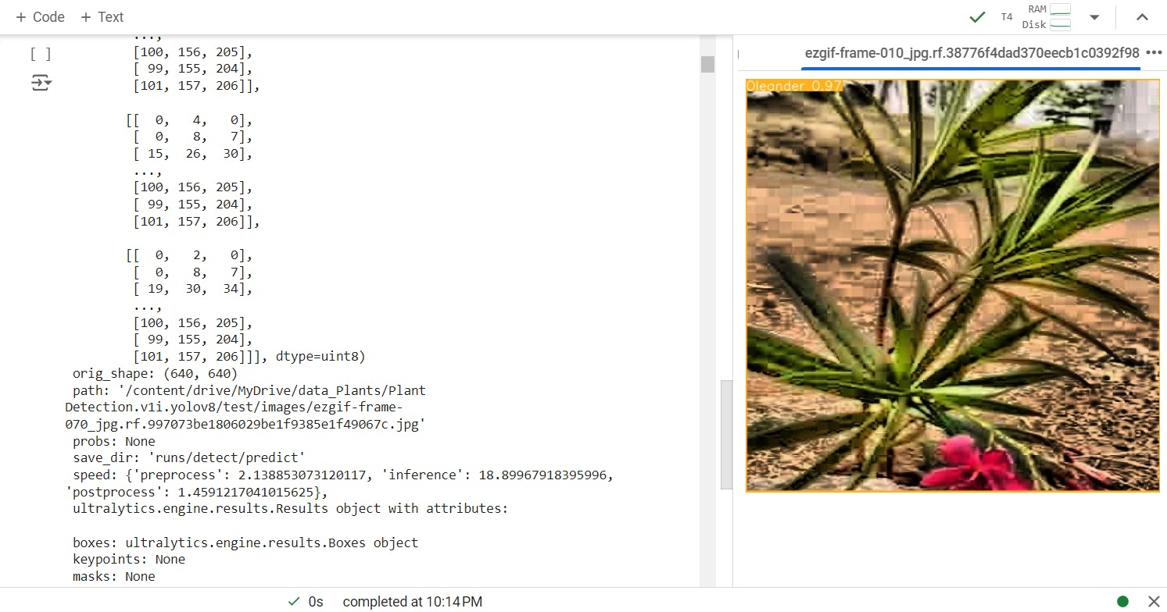
Output
Identification of Species
The trained model output image displays bounding boxes around detected medicinal plant instances, accompanied by class labels identifying the plant species. This output provides a visual representation of the model's successful identification and localization of medicinal plants.

Slide 15
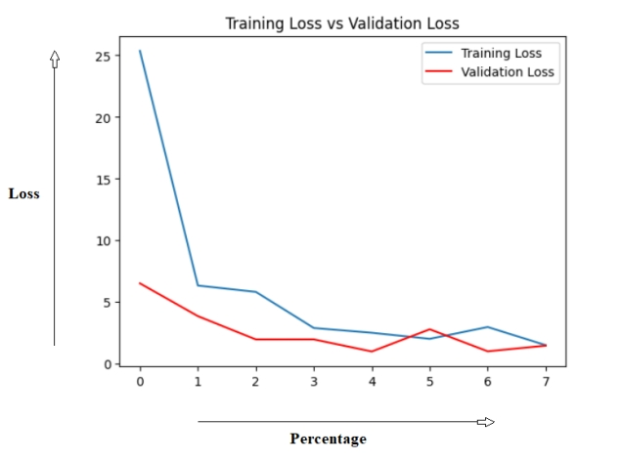
Performance

Slide 16
Conclusion
The ML-assisted image processing software for medicinal plants revolutionizes plant management with high efficiency and precision. Utilizing the advanced YOLO v8 algorithm, it significantly enhances plant identification, classification, and monitoring. The software supports sustainable practices through real-time monitoring and environmental analysis, ensuring responsible long-term resource management. Its collaborative features promote a shared knowledge base and best practices, fostering cooperation among researchers and practitioners. This innovative tool drives advancements in medicinal plant research and cultivation, streamlining processes and unlocking new possibilities for sustainable and effective plant management..

Slide 17
References
Chanyal H, Yadav RK, Saini DKJ. Classifcation of medicinal plants leaves using deep learning technique: a review. Int J Intell Syst Appl Eng. 2022;10(4):78–87.
Rao RU, Lahari MS, Sri KP, Srujana KY, Yaswanth D. Identifcation of medicinal plants using deep learning. Int J Res Appl Sci Eng Technol. 2022;10:306–22.
Singh V, Misra AK. Detection of plant leaf diseases using image segmentation and soft computing techniques. Inf Process Agric. 2017;4(1):41–9.
Malik OA, Ismail N, Hussein BR, Yahya U. Automated realtime identifcation of medicinal plants species in natural environment using deep learning models
Valdez DB, Aliac CJG, Feliscuzo LS. Medicinal plant classifcation using convolutional neural network and transfer learning. In: 2022 IEEE International Conference on Artifcial Intelligence in Engineering and Technology (IICAIET). IEEE; 2022.

Slide 18
Thank You

